Slide 1
Spark Pipeline

Slide 2
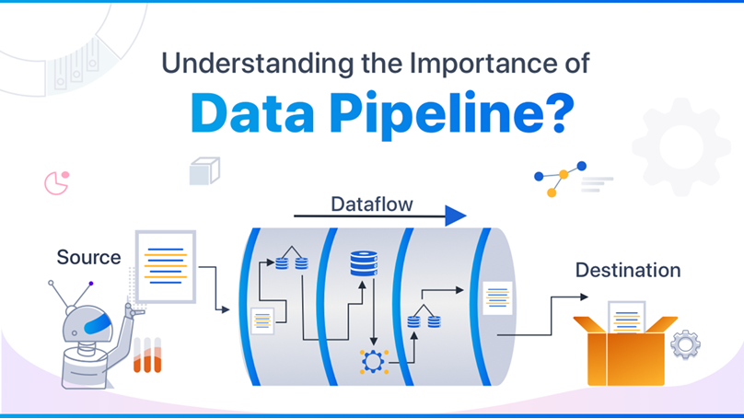

Slide 3
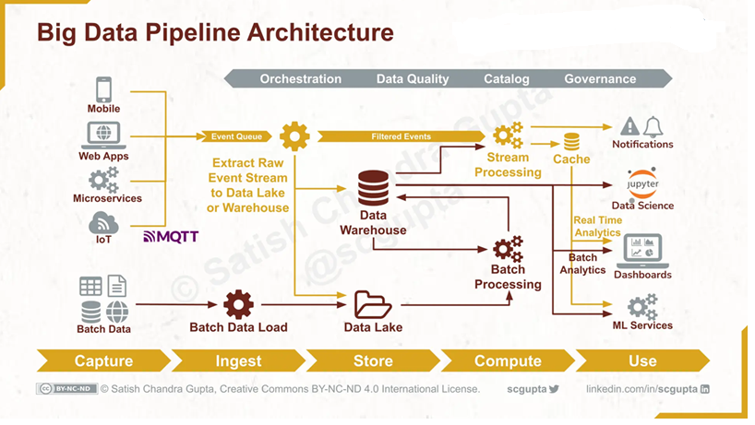

Slide 4
A Spark pipeline is a sequence of data processing steps where raw data flows through transformations and finally produces a result when an action is triggered.
Data comes in → we clean/transform it → we ask Spark to produce output

Slide 5
Built using RDDs / DataFrames
Steps are lazy
Execution happens only when an action is called
Internally represented as a DAG

Slide 6
WHY do we need a Pipeline?
Without pipeline (problem):
Huge raw data
Manual steps
Slow processing
Hard to debug
Not scalable

Slide 7
With pipeline (benefits):
✔ Structured flow ✔ Reusable logic ✔ Optimized execution ✔ Fault tolerance ✔ Scales to TBs of data

Slide 8
Pipeline brings order, optimization, and scalability to chaos.

Slide 9
Use Spark pipelines when:
Data is large
Processing is repeatable
Steps are dependent
Data is distributed
Speed matters
Not ideal when:
Very small data
One-time calculation
Simple scripts

Slide 10
WHERE is a Spark Pipeline used?
Real-world places:
Telecom billing systems
Banking fraud detection
E-commerce recommendations
Log analysis
IoT sensor analytics
Data warehouses (ETL)
Anywhere data is big, continuous, and valuable.

Slide 11
HOW does a Spark Pipeline work?
Step-by-step flow:
Create SparkSession
Read data (CSV, JSON, Parquet, DB)
Apply transformations
filter
select
withColumn
groupBy
join

Slide 12
Build DAG (internally)
Trigger action
show
count
write
Spark executes optimized plan

Slide 13
Analog1
Spark | Cooking
Raw data | Raw vegetables
Transformations | Cutting, washing, seasoning
DAG | Recipe
Action | Serving food
Spark | Chef + kitchen

Slide 14
Analog2
Spark | Factory
Pipeline | Assembly line
Transformations | Machines
Lazy evaluation | Machines stay idle
Action | Customer order
DAG | Production plan

Slide 15
Analog3
Laundry Example (Very Relatable)
Collect clothes → sort → wash → dry → fold
You don’t start washing until you decide to do laundry

Slide 16
Analog4
Cab Booking (Optimization analogy)
You choose destination (action)
App finds best route (optimizer)
Driver executes journey (executors)

Slide 17
UsesCases in Spark Pipeline
Telecom
Filter failed calls
Aggregate duration by customer
Join with SLA table
Identify SLA breaches

Slide 18
Banking
Filter high-value transactions
Group by account
Detect anomalies

Slide 19
E-commerce
Clickstream cleaning
Sessionization
Recommendation features

Slide 20
SCENARIO-BASED EXPLANATION
Scenario: Telecom Call Analysis
Read CDR → Filter dropped calls
→ Group by region
→ Join SLA reference
→ Flag SLA breach
→ Write report

Slide 21
“Spark pipeline is not about writing steps. It’s about declaring intent, letting Spark optimize execution, and running it only when results are needed.”

Slide 22
Questions
Why does Spark delay execution?
What breaks if there is no action?
How does DAG help in fault tolerance?
Can two pipelines share stages?
What happens if data size doubles?

